Slide 1


Coaches Meetings
TBall
Saturday March 2, 2019

Slide 2

Agenda
Sign In
Introductions
NLLL Philosophy and The Importance of Our Culture
Getting Started
  Volunteers
  Forms and Administration
  Practice Planning
Rules and Game Operations
League Functions
  Fields
  Scheduling
  Safety
  Fundraising
  Little League Day at T-Mobile Park
  Concessions
Equipment
Notes:
Speaker: Corey

Slide 3
NLLL Coaching Philosophy and our Golden Rules
Little League Parent/Volunteer Pledge
I will teach all children to play fair and do their best.
I will positively support all managers, coaches and players.
I will respect the decisions of the umpires.
I will praise a good effort despite the outcome of the game.
The NLLL Coaching Mission Statement (new for 2019):
"The standard of performance and expectation for North Lake Little League managers and assistant coaches is to consistently display an exemplary level of respect and concern for the welfare, development, and positive experience of ALL player, coach, volunteer, and parent members of the North Lake community.”
Conveying to all adults (fellow coaches and parents) that our sole purpose is to build the skills and support the development of ALL kids on the field and throughout the league.
BE POSITIVE!!! Learn to expunge “Don’t do that / Why did you do that? / That’s not right” from your vocabulary
Psychology tells us it’s a FACT that negative imagery and words are 90% more likely to stick in the brain than positive--therefore when teaching skills don’t emphasize the wrong way.
Three positive comments for every Critique; Five for every disciplinary action
Providing them with a positive role model at all times
Preparing them physically and mentally to compete effectively, fairly and safely in sports
Bringing a level of true and deep concern for the health and welfare of ALL the kids
Teaching the players to interact and support each other as part of a team, and to treat their opponents with the same respect
Providing them the opportunity to play all positions to enable them to learn the sport (especially in the younger divisions)
Remembering that children mature, physically and emotionally at different rates. Their ability can change from one month to the next
Remember they are children not young adults
Notes:
Speaker: Corey and Rich

Slide 4

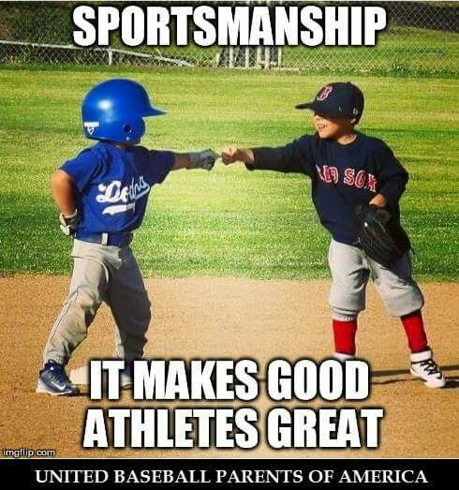
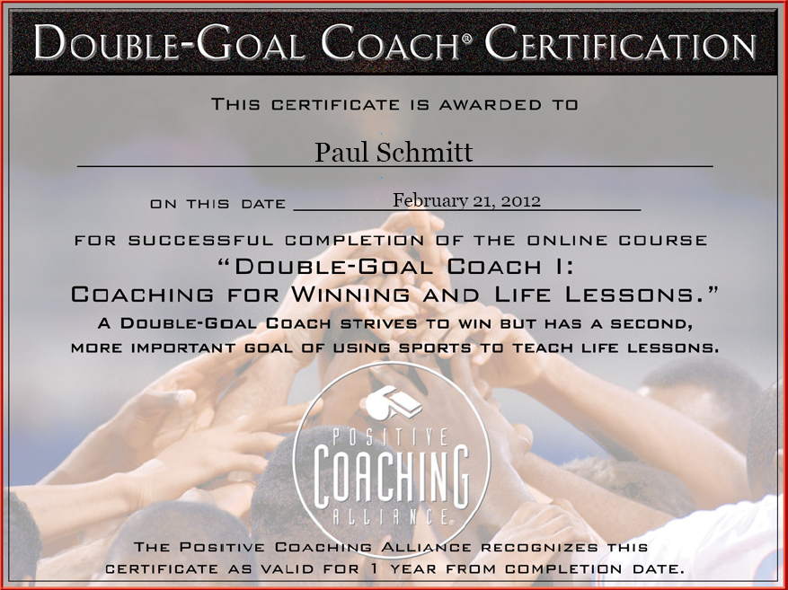
Double-Goal Coach®: Coaching for Winning and Life Lessons
Required – training from a nationally accredited course
Notes:
Speaker: Corey

Slide 5
So you’re going to coach a team…
Role model, leader, expert, official, educator, negotiator, coordinator, planner, accountant, procurement, cheerleader, psychologist, motivator…
You can’t do it all yourself, demand participation: “It Takes a Village to Run a Team” – All families should have at least one responsibility for the season
North Lake Little League is a 100% volunteer organization and we need parents to actively participate
  All Assistant Coaches need to complete a Coach Registration on the league website--Umpires will have a registration as well
  Let them know that this can be a fun family activity if they participate on the field at practice
  Happy to support you at your parents meeting
Develop your skills as a coach so you grow as your child moves through the levels
Notes:
Speaker: Corey

Slide 6
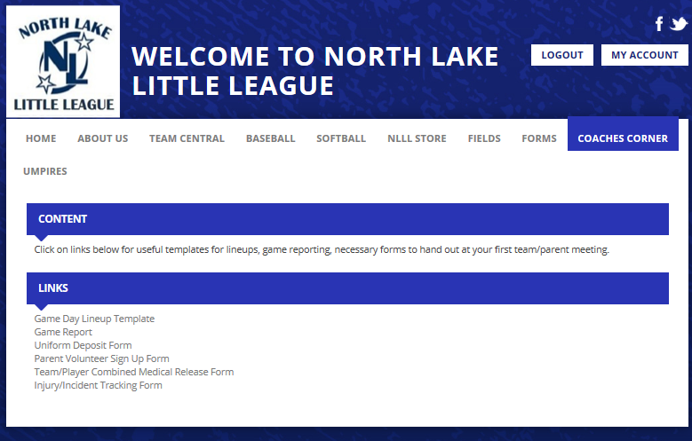
Forms
www.northlakell.org (Log In > Main Page
Required Forms for Parents (NLLL Forms)
  Medical Release Form (PDF or .doc)
  Concussion Information Form
  Parent Code of Conduct (Grandparents, Aunts/Uncles, Friends)
  Volunteer Application (if needed)
Injury Tracking Form (print several and keep with you)
Notes:
Speaker: Corey

Slide 7
Starting the season
Parents’ Meeting
  Set Expectations
  Involve every parent
  Checklist of required forms etc.
  Happy to support you at your parents meeting
  Volunteers, Volunteers, Volunteers – make a sign-up sheet for all of the volunteer jobs and take to the meeting
Coaches Meeting
  Plan a separate meeting (coffee) with your staff
  Get in sync on what, and how, you will be doing during the season
Communication Plan
  Weekly update e-mail
  Group SMS and/or e-mail list to communicate last minute changes (due to rainouts, etc.)
Notes:
Speaker: Corey

Slide 8
Practices
Focus on the basic techniques early in season: 1) Throwing 2) Catching 3) Hitting
Have a practice plan!
  Doesn’t have to be elaborate, rigid, or complicated
  Share with assistants BEFORE practice so that they know how they can help you in setting up drills to save time in transition.
  Sample practice plans available on the web or through NLLL
Demand on-time arrival; end on-time
  Arrive before with time to get ready.
  Idea: ”early bonus” wiffle ball hitting incents players and parents to show up early
  Start practice on time with the players who are there: Late arrivers need to warm up on their own before they can join
Minimize chaos and wasted time by managing the spacing of the kids
  Use cones or carpet “bases”
Set game expectations for how you play by how you practice
  Routine
  Drills vs skills
Notes:
Speaker: Corey

Slide 9
Hitting Cage Sessions
Juniors BB, Majors / Minors SB and BB
Preseason 3 Sessions (max 1 at Rijo)
89ers SB, AAA BB
Preseason 2 Sessions (max 1 at Rijo)
Sluggers/Rookies / T-Ball/Farm Softball
(2) Sessions available if requested (max 1 at Rijo)
In-season allotment TBD
In-season allotment TBD
Northshore Sports Complex
  14220 NE 193rd Place
  Woodinville, WA 98072
  (425) 485-3238
  nsc9@frontier.com
Tom’s Barn (Sunday mornings until 3/31)
  24211 47th Ave SE
  Woodinville, WA 98072
  Contact: NLLL President
Rijo Athletics
  22620 State Route 9 SE
  Woodinville, WA 98072
  (425) 486-4878
Notes:
Speaker: Corey

Slide 10






Resources
www.northlakell.org
NLLL Board and Coaches
  Players Agent is there to resolve parent/player issues
  Coaches Coordinator, VPs, and President can consult on game play questions
https://www.littleleague.org/play-little-league/tee-ball/
https://www.littleleague.org/play-little-league/coach-pitch/
http://www.littleleagueconnect.org
http://www.gamechanger.io
Big Al Baseball: www.bigalbaseball.com
Notes:
Speaker: Corey

Slide 11
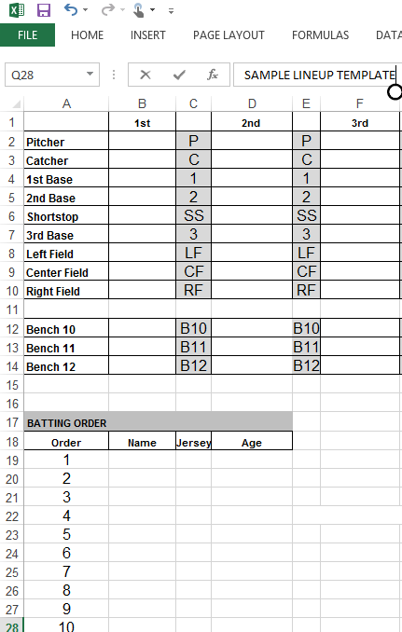
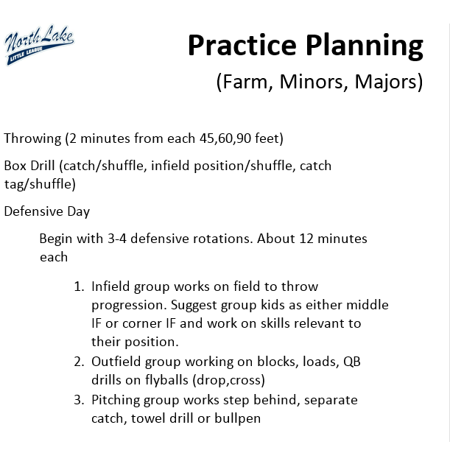
Coaches Corner: Planning Tools
Sample Lineup Templates
Practice Plan Guide
Notes:
Speaker: Corey

Slide 12
Game Play – T ball
Print, read, and understand : 2019 NLLL Supplemental Rules
Most commonly overlooked elements
    All players used on defense.
      Up to 7 players in the infield
      Coaches are allowed on the field.
      Encourage proper spacing of players.
    Bases can be adjusted to 50’ if necessary
    15’ minimum travel distance in front of the plate (draw a chalk arc)
    A batted ball advances batter-runner and runners (1) base. Coaches may opt for (2) bases when ball travels untouched to the outfield. Confer with the other coach on this topic before the game
    Rotate your batting order each inning.
Notes:
Speaker: Brett

Slide 13
Field Prep – Mark Madigan markio506@gmail.com
Bastyr Field Prep Training and Setup Day: Saturday March 9th 9:00am to 3:00pm—Every team must send at least one parent
Field prep is EVERY team’s responsibility
Assign parents to do pre and post game prep
The HOME team is responsible to prepare the infield for safe play to the satisfaction of the umpire
If you are the last practice or game of the day:
  Close down the field (which includes dragging the field if at Bastyr)
  Make sure that the bases are put away and the base caps are put back in the pegs, and covered with (sand)
VISITOR team is responsible for tear down
Both teams: clean up all garbage

Slide 14
Field Prep Do’s and Don’ts
Do not leave a field at Bastyr without dragging it, ever! Never leave the field “used”, rain will puddle on an unraked field but a smooth field can tolerate an overnight “Seattle rain” and be ready the next day.
Don’t use a broom to disperse puddles
Don’t sweep a puddle into the grass
Don’t drag on the grass
Don’t throw or hit balls against the fences
Do use a pump or puddle pillow to remove standing water
Do remove bases & replace base caps before dragging
Do fill holes and low areas
Notes:
Speaker: Paul

Slide 15

Important Numbers
Field | Phone
Northshore School District Fields | 425-408-6020
Forsgren and Logan Park (decision made by 3 pm) | 425-388-6030
City of Bothell (Moorlands, North Creek, Doug Allen, and Cedar Grove) | 425-806-6102
Northshore Athletic Fields (NAF) | 425-486-7333
Bastyr | Coaches' decision
Bastyr Security (to open gate) | 206-850-1710
Field | Combo
Bastyr | 4438
Arrowhead | 4438
Moorlands Park | To be confirmed
Forsgren Park | 6829
Chain lock for mounds at North Creek | NLLL-6829 NSLL-8787
Brier Park | 4438
Logan Park | 2013
NSD Gates with keys inside | NSD

Slide 16
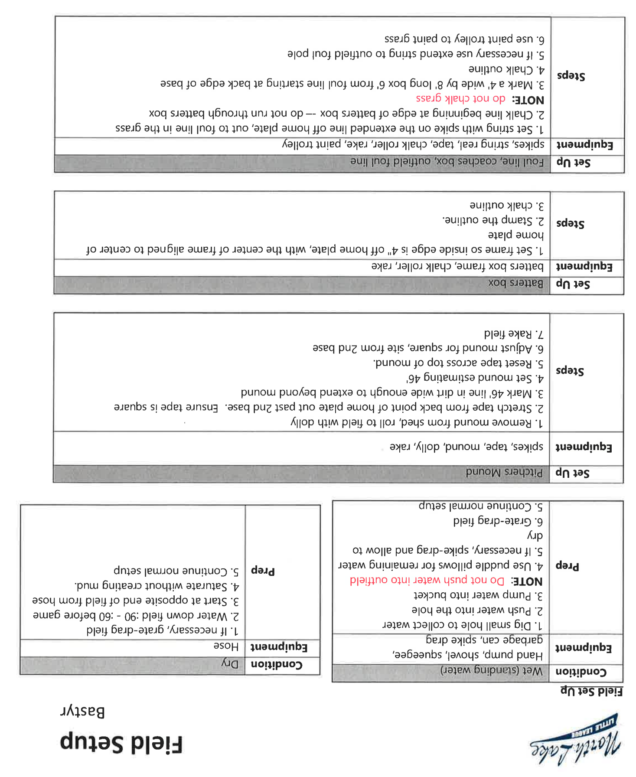
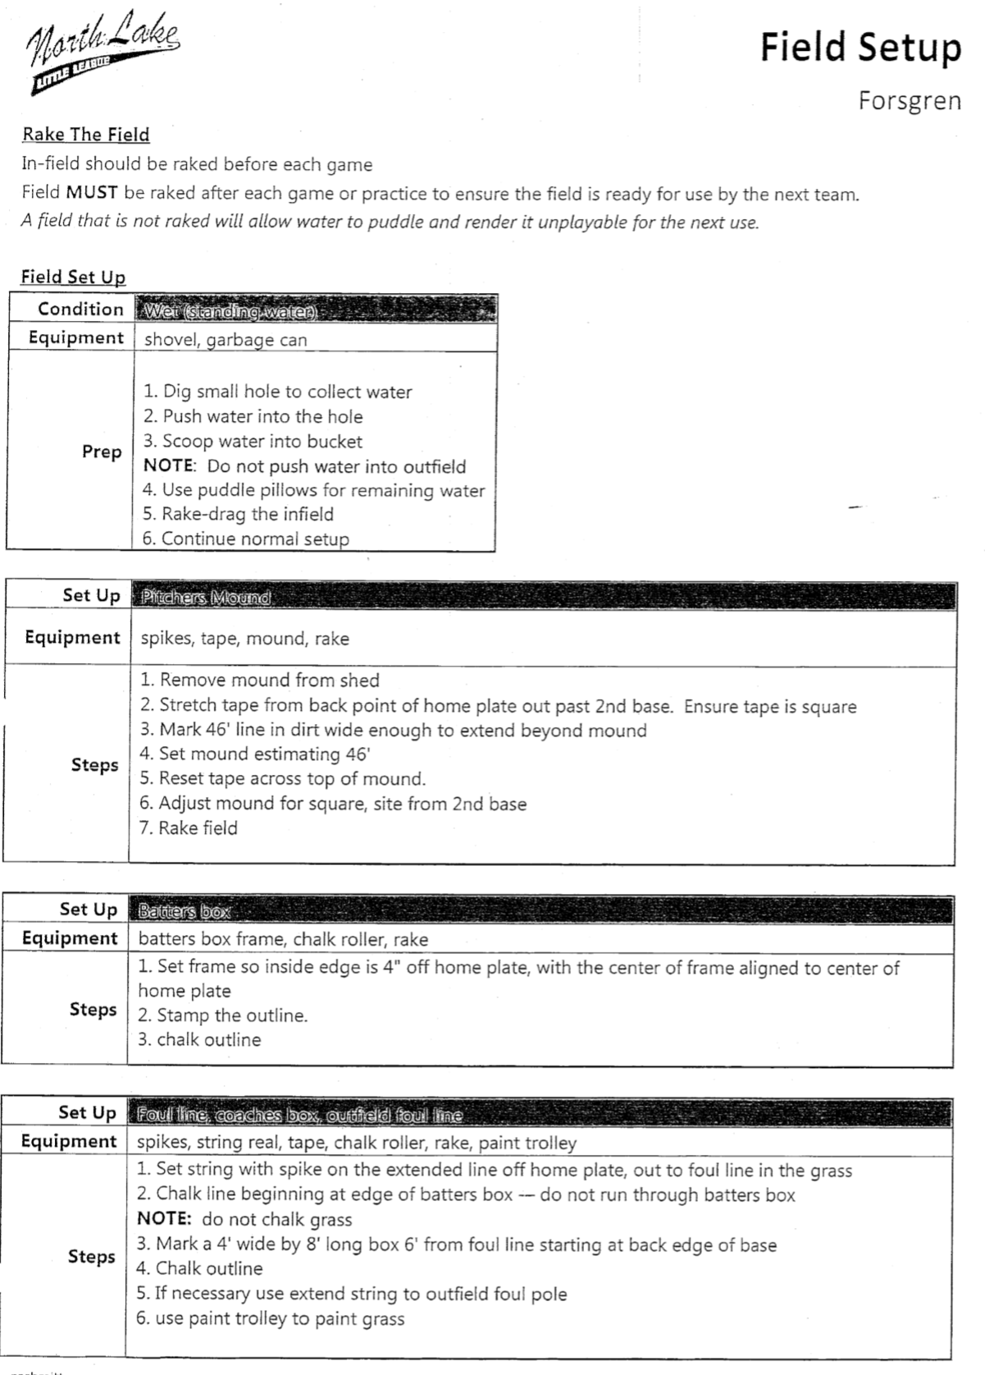
Field Setup—Bastyr and Forsgren

Slide 17
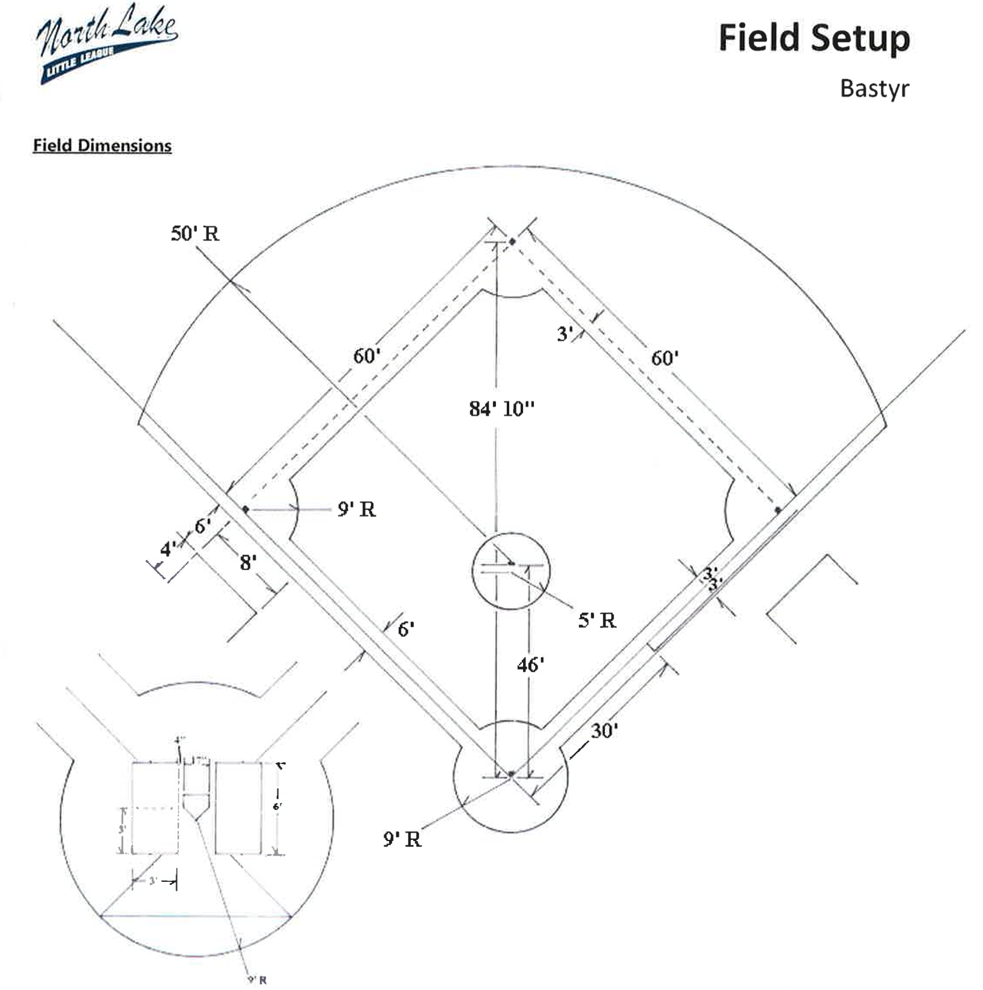
Field Prep
Cocoa matt drag the field before every game, pick up rocks
Rake and prep the batter’s box – fill in the “footprints”
Set batter’s box (3’x6’) with chalk (tip: rakes are 3’ wide)
Measure and set field dimensions
  Mound: 46’ from front of rubber to back tip of Home plate
  Bases: 60’ from base to base and 84’ 10” from Home plate to 2nd Base
Use the twine to set a chalk-line from home to 1st & 3rd
Be prudent with the use of chalk: no chalk in grass or decorative drawing
Set cones (if no fence): 200’ for Majors, 180’ for Minors, 150’ for Farm and below
Cocoa matt drag the field after every practice or game
Never leave the field “used”, rain will puddle on an unraked field

Slide 18
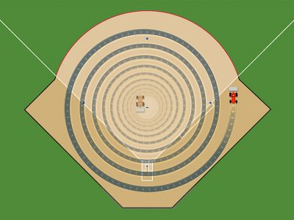
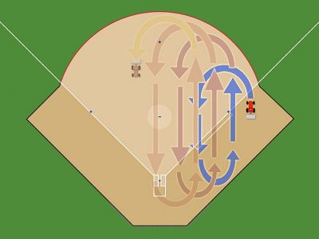
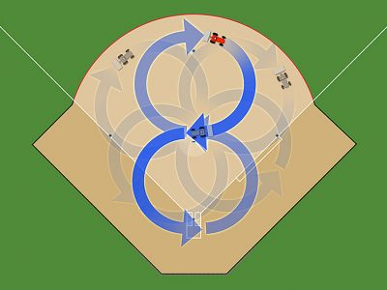
Post-Game Mat Drag
(Bastyr)
Choose a different pattern than you did last time
Start at the day position
  M/W/F: 1st base
  Other: 3rd base
Water prior to games and practices more deeply than just to settle dust, then have players pick up rocks—it goes very quickly!
After last game for the night, cocoa mat one of those patterns below
Circles, outside → in
Overlapping Ovals
Figure 8
NEVER INSIDE → OUT

Slide 19
Scheduling – Mandie Neher
scheduler@northlakell.org
2019 NLLL team count: 50 (6 more than 2016)
If you are granted a field (especially turf) and it is NOT rained out by the field owner and you cancel the practice/game due to rain and not because of a true safety problem…..then…..
Field scheduling is extremely complex. Be:
  Flexible
  Nice
  Reasonable
  Patient
Scheduler requires quick responses to set a plan in motion
Mother Nature can be everyone’s enemy
Field access is often out of league’s control
Make-up Games/Practices
  Use your normal practice time/location as the first choice for a make-up game.
Notes:
Speaker: Corey

Slide 20
Safety – Debbie Hogge sdhogge1@gmail.com
Safety Forms
  Online at northlakell.org
  Medical Releases
  Injury Tracking Form
  Emergency Contact Form
First Aid Kit
  Contents
  Replenish
Training
  Today’s training
  March 2nd if needed
3 Instant Ice Packs 2 Plastic Bags for Ice 6 Antiseptic Wipes 2 Large Bandages 2” x 4” 2 Large Non-stick Bandages 20 Band Aids 1” x 3” 2 Antiseptic Cream Packs 1 Roll 2” Sports tape 2 Eye Pads 1 Roll of Gauze 2 Burn Cream Packs 1 Pair of Latex Gloves 1 Pair of Tweezers 2 Sterile Gauze Pads
Notes:
Speaker: Kevin

Slide 21
Safety
You are responsible for each player from the time they are dropped off until their parent picks them up, or somebody designated by their parent. Players are NOT to be left alone. Make sure kids don’t wander into the woods at Bastyr before or after practice.
Incident Forms: www.northlakell.org
Ice! Assign a parent to bring (real !!) ice to every practice and game
Note: needs to be someone dependable
Batting Cages – bats down!
Throwing – don’t walk between the lines
Curb uncontrolled throwing or hitting or horseplay – No Flyers’ Up
Someone will get a ball in the face at the first practice
  Be prepared, be calm
Notes:
Speaker: Kevin

Slide 22
Safety
Injuries
  Always notify parent
  Severe: call 911
  Managers carry Medical Releases
Treatment
  Cuts & scrapes
    Clean, dress, no blood on uniform
  Bumps
    Ice
  Concussion
    Lystedt Law
Fields
  Inspect prior to game
  Both teams should do a “rock walk” before the game
Equipment
  Inspect before season, all must have current certification
  Cups , no jewelry
Games & Practices
  No bats, except batter
  Players stay in dugout
  Bats down in batting cages
Facilities
  Parents supervise siblings
  Lightning
  No dogs, tobacco, alcohol, or sunflower seeds
Discipline
  Keep control of team – stay safe
  No “uncontrolled play” before or after practice
Notes:
Speaker: Kevin

Slide 23
Fundraising/Sponsorship
Each team must have a designated Fundraising and/or Family Fun Day Coordinator
  League contacts:
    Andrew Holes—Sponsorship: andrew@jwilburfoods.com.
    Get the word out!! We are an all volunteer league!
Family Fun Day
May 18, 2019 Time TBC (likely 10:00am to 4:00pm) @ Bastyr
  Get the word out!! We are an all volunteer league! Family Fun Day provides more than $5000 to the league budget
  Team pictures - $4.50 per player back to NLLL
  Derby and Skills - players collect pledge money
  Silent auction - team theme baskets
  Family carnival All day: games, dunk tanks, etc.... Prizes, food, fun
  Team fundraising packets distribution
  All FFD information/forms will be posted to NLLL website
Sponsorships and Corporate Matching (NLLL is 503(c) )
  We LOVE the small businessperson and can provide relatively inexpensive exposure to 300+ Kenmore/Bothell families
  Corporate Matching Program (e.g. Microsoft, Boeing ) – Umpires, Coaches, Scorekeepers
Notes:
Speaker: Lori

Slide 24
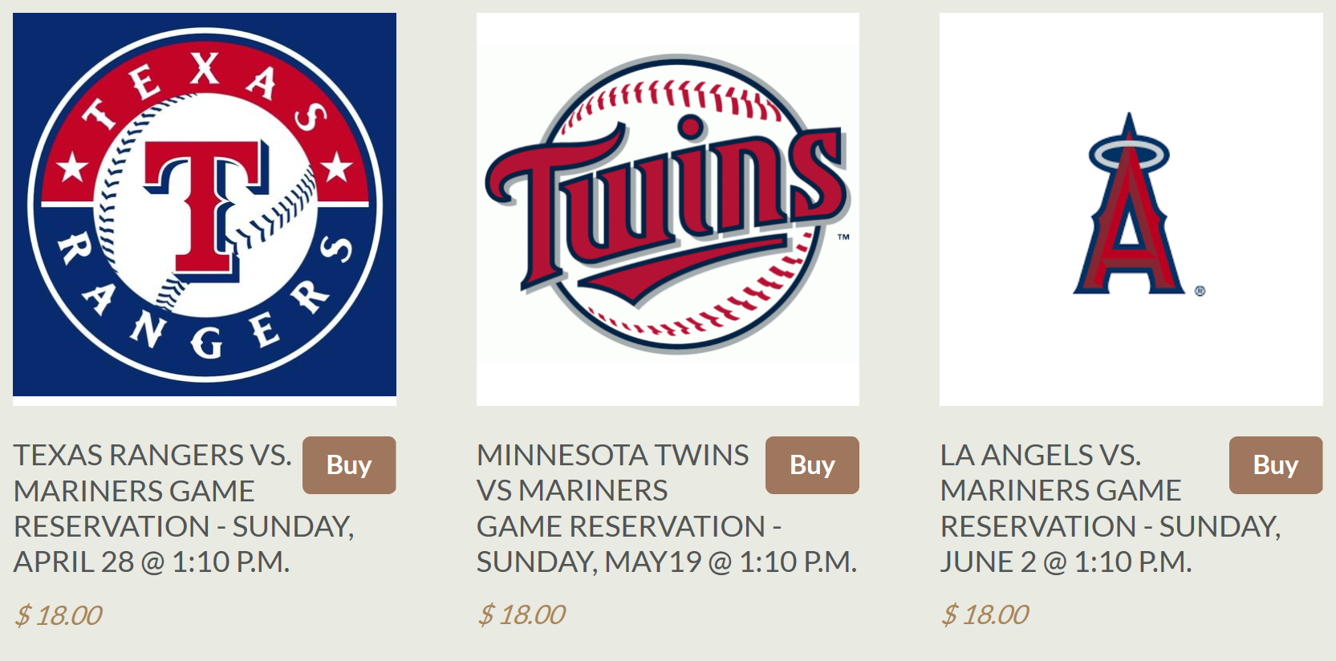
Little League Days at T-Mobile Park!
Game Dates: April 28, May 19, June 2
Choose a Mariner’s Little League Day Coordinator and game to attend by March 18. Parents can order tickets through NLLL for other games, too.
Minors and Majors teams note that ToC games after Memorial Day can conflict with the June 2 date—no refunds
Send the name of your volunteer and the your game choice to Danny Howe by April 1st at baseballvp@northlakell.org
Why the earlier deadlines? Early season Angels game.
Now-April 1: Parents visit http://northlake-little-league-store.myshopify.com to pay and reserve their tickets. They must indicate their team name in the shopping cart.
Once tickets arrive, they will given to M’s Day Coordinators for distribution to each team. They will also be given a spreadsheet with all their team orders.
$3.00 per ticket fundraising fee added for NLLL. $18.00 ticket total
Parade on the Field before the Game 11:10 am to Noon
Notes:
Speaker: Alex or Corey

Slide 25
Concession Stand at Bastyr
Concessions@northlakell.org
Concessions are pending refurbishment of the trailer – stay tuned
NLLL Bastyr Concessions
Brings in several thousand dollars a year
Available during games at Bastyr fields and Family Fun Day
Provides a fun service for NLLL families
In order to increase revenue and provide a more consistent service, we are asking for one parent volunteer from each team to help out during the season. The Team Concessions Parent Volunteer would be helping out only during his/her team’s games at the Bastyr fields.* The coordinator will set up a volunteer schedule to provide each team equal opportunity for participation. A volunteer sign up will be email to each volunteer.
Please submit your team volunteer ‘s name and contact information to Genoveva Marin, NLLL Concessions Coordinator. Thank you!
Team Concessions Parent Volunteer*
Responsibilities
Assign somebody to work the concession trailer (older children are invited to help out)
Open and lock up the concession trailer
Secure money from sales in the black file box for collection by Genoveva Marin, Concessions Coordinator
Concessions “tours” available at Bastyr fields by request. Please email, text, or call to set up a time
Contact Genoveva Marin: Concessions@northlakell.org
(425) 770-3341
Notes:
Speaker: Alex or Corey

Slide 26
Equipment List – Chris Scott
ALL
You do not have to return the balls, but you can if they are in good shape and you won’t coach at the same level next year.
All other hard gear must be returned at end of season
If you need any other gear during the season, I can resupply you (baseballs, equipment, etc.) Send an email to hardgoods@northlakell.org
AAA - equipment bag with 2 bats, 2 doz practice balls (all weather), 1 doz game balls, 1 doz wiffle balls,
pitch counter, scorebook, Tee, throw down bases, catchers gear
Rookies and Sluggers - equipment bag with 2 bats, throw down bases, hitting tee, catchers gear, 2 doz practice balls, 1 doz game balls
T-Ball - equipment bag with 2 bats, throw down bases and hitting tee, 2 doz practice balls-1 doz game balls
Notes:
Sync with Mike

Slide 27
Handouts
First Aid Kits
Green/Orange Books
Your team equipment
Coach’s drill card deck
PCA Book for Managers
T-Ball Coaches Guide

Slide 28
Thank You and…Play Ball!

